Slide 1

Electricity Bill Generator
By Ramjee Mishra / 150096725007
Case Study Number: 18

Slide 2
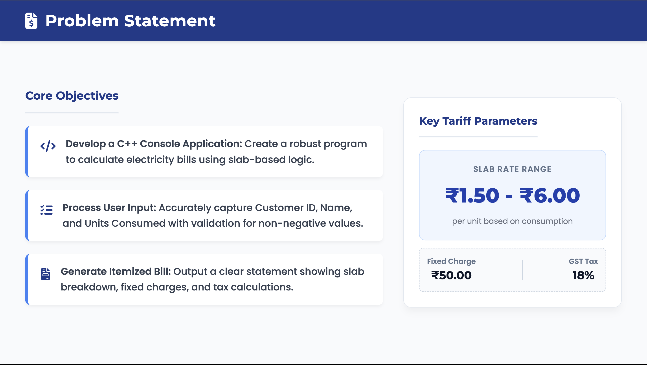

Slide 3
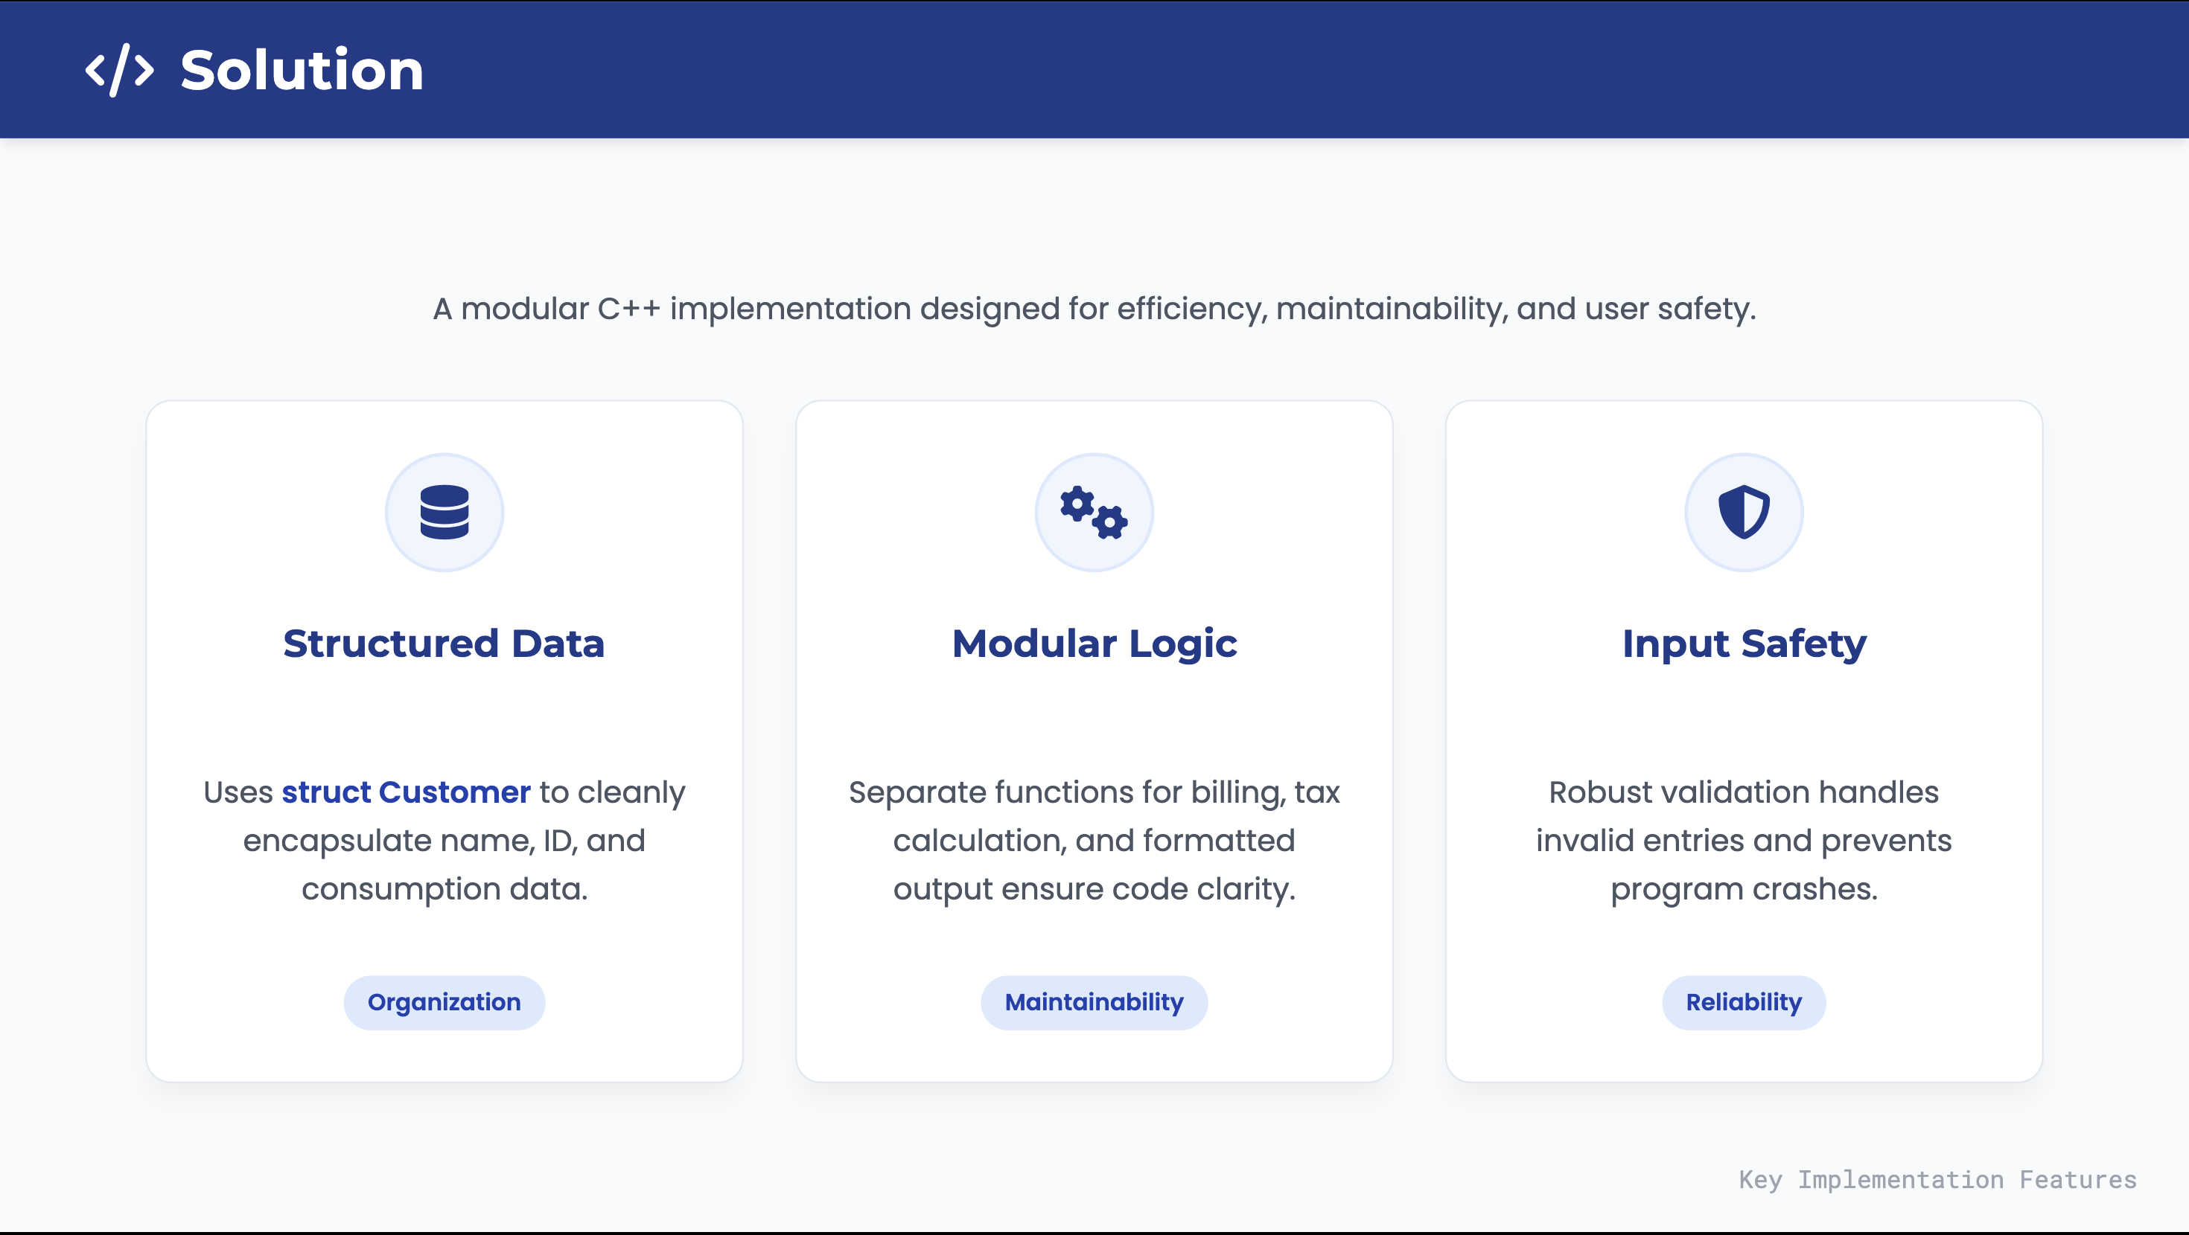

Slide 4
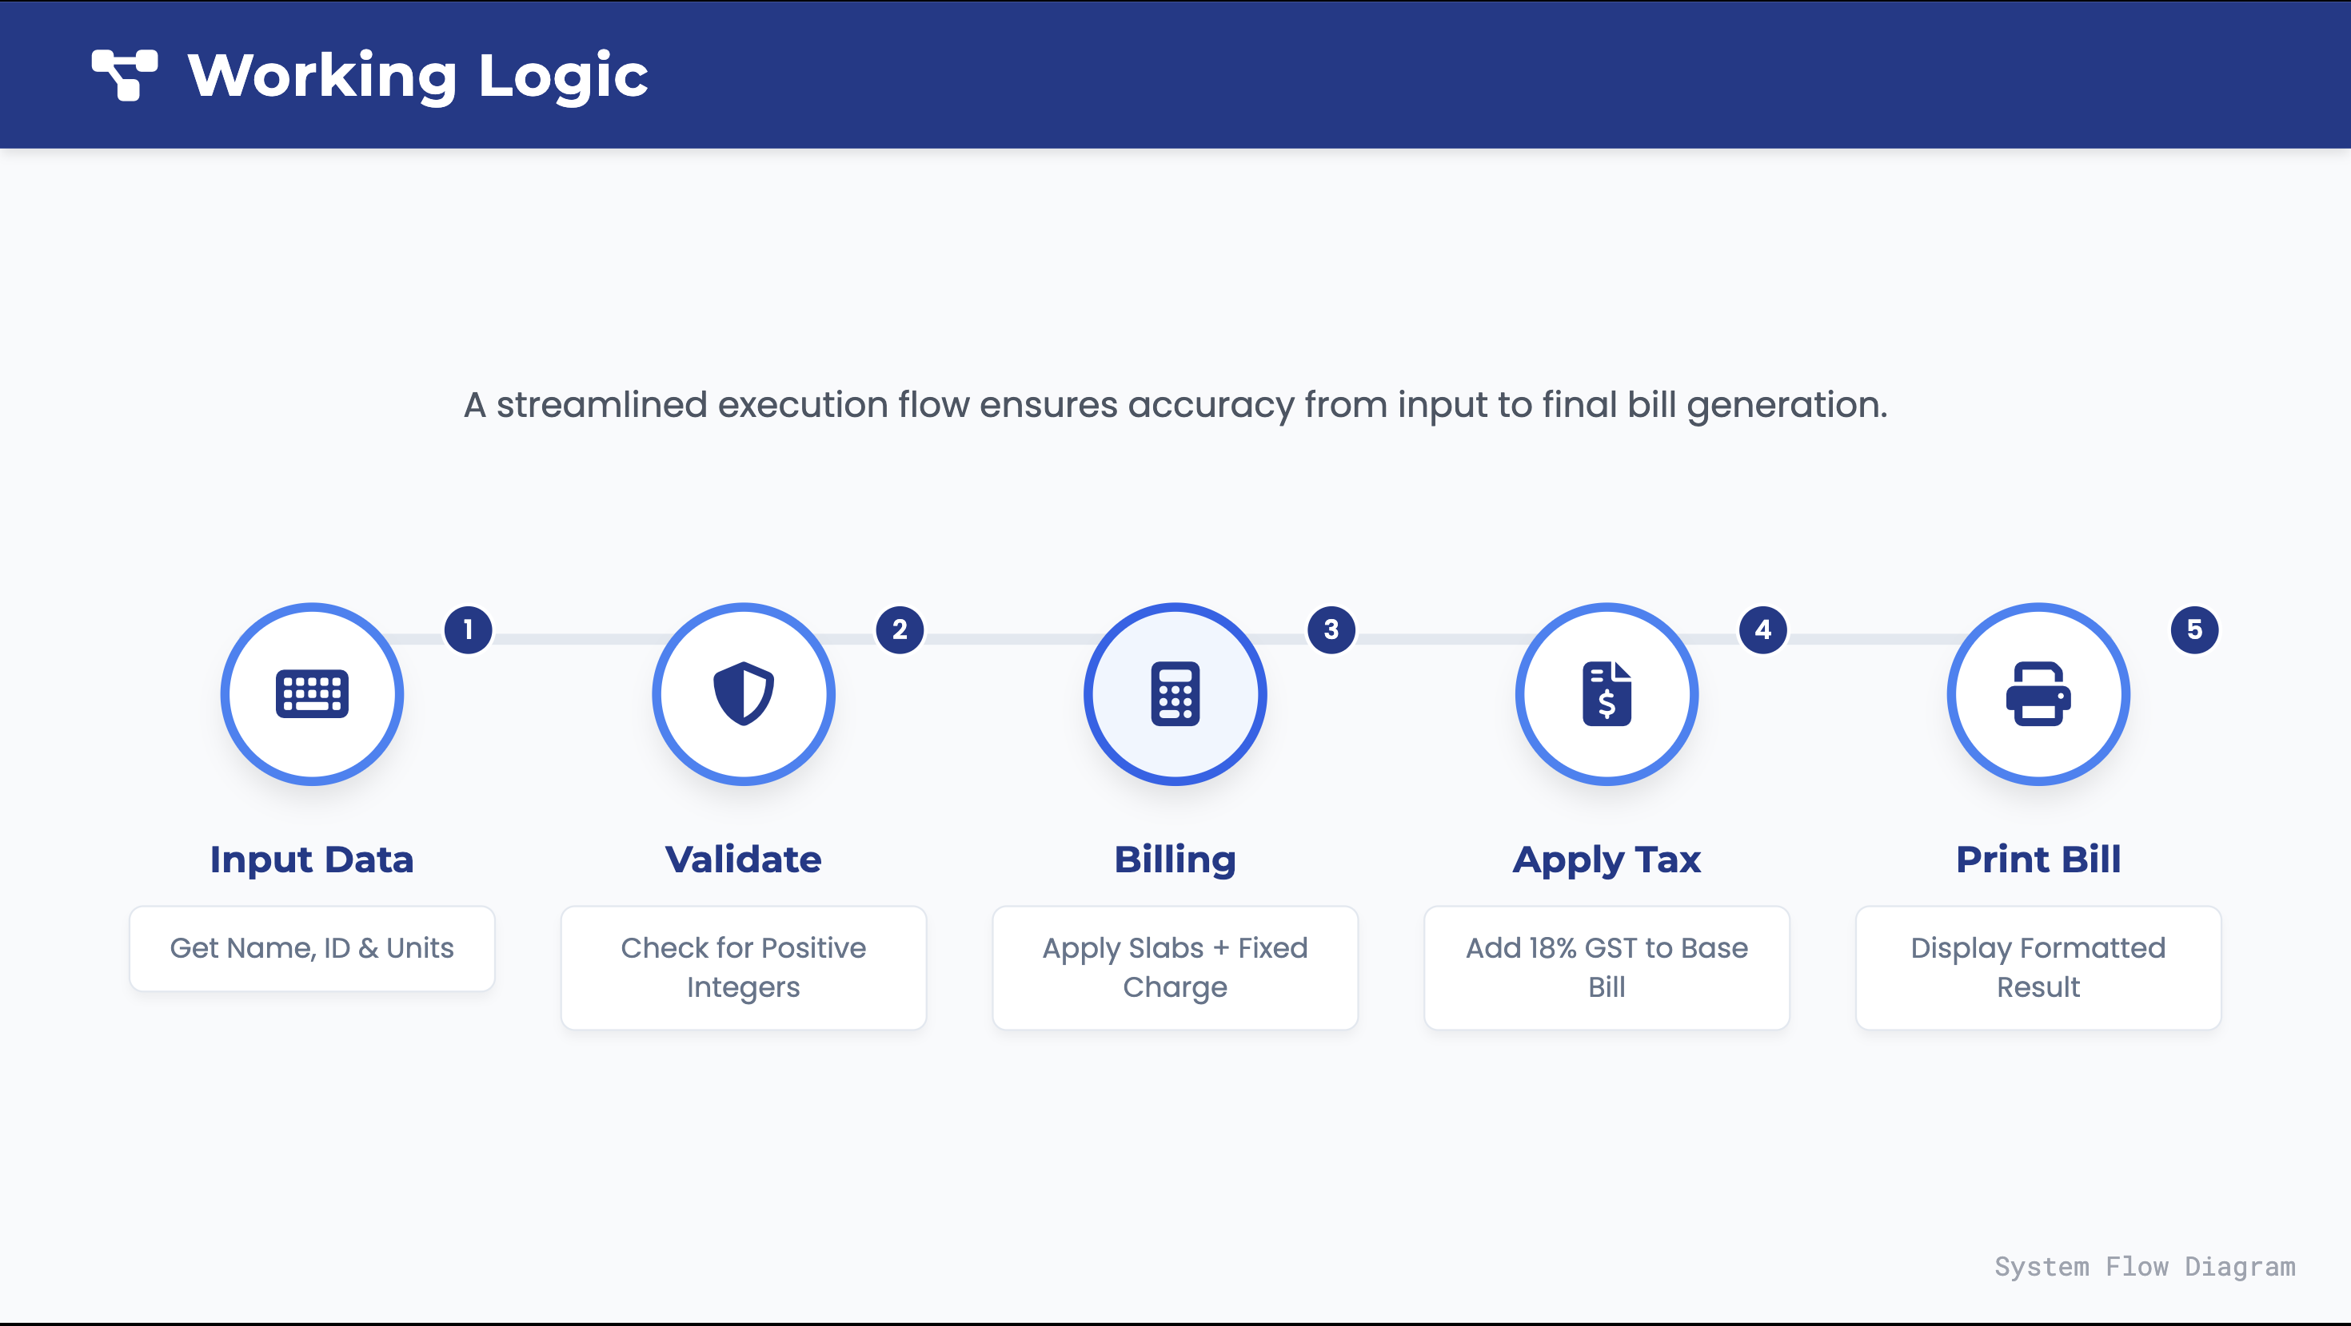

Slide 5
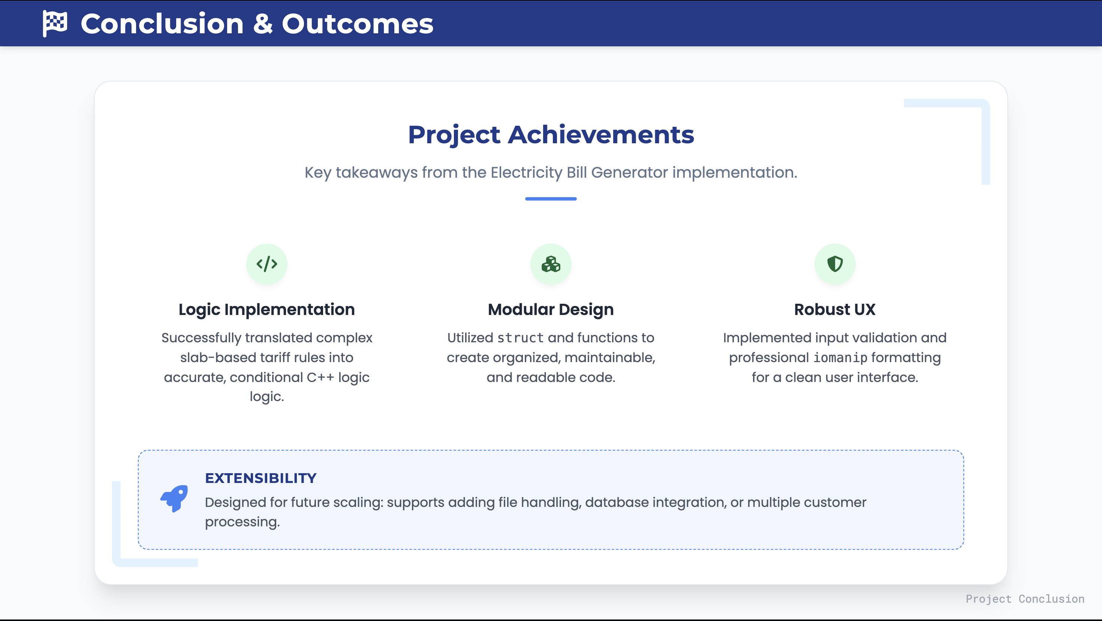

Slide 6
Thank You

